Slide 1
STATISTICS FOR BIG DATA MSC DATA SCIENCE
Homework 3
Student: Leon Kalderon
A.M. : DS3617005
CASE: variable screening/selection with regularization techniques in order to fit the best model for our goal variable (Number of murders)
DATASET: http://archive.ics.uci.edu/ml/datasets/communities+and+crime+unnormalized#
COMMUNITIES AND CRIME UNNORMALIZED DATASET
Size of dataset: 2215 observations
147 features
PC specs: 16gm DDR4, hq6700

Slide 2
INTRODUCTION
GENERALIZED LINEAR MODELS (GLM)
Our goal function is count data (Murders) so we use three GLMs with different distribution families.
Poisson regression
Poisson regression is used to model count data under the assumption of Poisson error (murders is a positive integer number), or otherwise non-negative data where the mean and variance are proportional. Like the Gaussian and binomial model, the Poisson is a member of the exponential family of distributions. A Poisson Distribution is parameterized by λ, which happens to be both its mean and variance which is not often realistic.
Negative Binomial Regression
The negative binomial distribution, like the Poisson distribution, describes the probabilities of the occurrence of whole numbers greater than or equal to 0. Unlike the Poisson distribution, the variance and the mean are not equivalent. This suggests it might serve as a useful approximation for modeling counts with variability different from its mean.
Gaussian Regression
The standard regression with some transormations so we get countable positive predictions.

Slide 3
REGULARIZATION TECHINIQUES
In order to apply feature screening we will use LASSO. However, we used Ridge and ElasticNet regularization for educational purposes, so we compare the shrinkage side by side.
Ridge Regularization (alpha = 0 ): Ridge regression shrinks the regression coefficients, so that variables, with minor contribution to the outcome, have their coefficients close to zero, but it will not set any of them exactly to zero
Lasso Regularization (alpha = 1):In the case of lasso regression, the penalty has the effect of forcing some of the coefficient estimates, with a minor contribution to the model, to be exactly equal to zero. This means that, lasso can be also seen as an alternative to the subset selection methods for performing variable selection in order to reduce the complexity of the model. One obvious advantage of lasso regression over ridge regression, is that it produces simpler and more interpretable models that incorporate only a reduced set of the predictors.
ElasticNet Regularization (alpha = 0.5 , could be any value 0<a < 1): Elastic Net produces a regression model that is penalized with both the L1-norm and L2-norm. The consequence of this is to effectively shrink coefficients (like in ridge regression) and to set some coefficients to zero (as in LASSO).

Slide 4
GRIDSEARCH WITH CROSS-VALIDATION
In order to find the optimal lambda(λ) of each method we do cross-validation.
As main criterion we use the mean squared error (out of sample). There are several other criteria that we use (auc, mae, dev, etc).
In order to obtain the optimal lambda(λ) we will use the function cv.glmnet() . The results that we mainly used are:
‘RegularizationObject’$lambda.min : This is the λ that has the best results for our out-of-sample measurement (‘mse’)
‘RegularizationObject’$lambda.1se: The most regularized model(the biggest λ) with CV-error within 1 standard deviation of the minimum.
The bigger the lambda the bigger the penalty of the regularization
In general, from CV we get big lambdas. That could be explained that our features are colinear!
We should mention that, regularizations are highly affected by the scale of the predictors. Therefore, it is wise to standardize the predictors before applying the ridge regression , in order to all the predictors are on the same scale. The most packages apply this standardization by default.

Slide 5
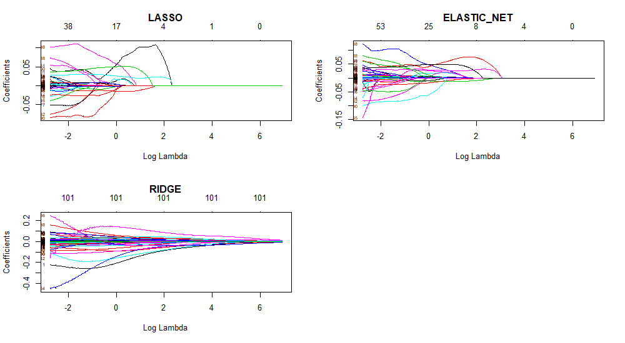
regularization OF THE COEFFICIENTS EXPLORATION
These plots show how the coefficient are shrinking as the penalty of lambda is getting bigger. Also on the upper x axis the labels show the number of coefficient that are not 0. As it was expected, as the penalty increases (λ) LASSO and ELASTICNET forcing coefficients to 0. However, Ridge shrinks the coefficients close to zero but they do not reach it exactly. For the reason we just mentioned, with the two first regularization techniques we can do variable screening/selection.
Poisson Regression Regularizations

Slide 6
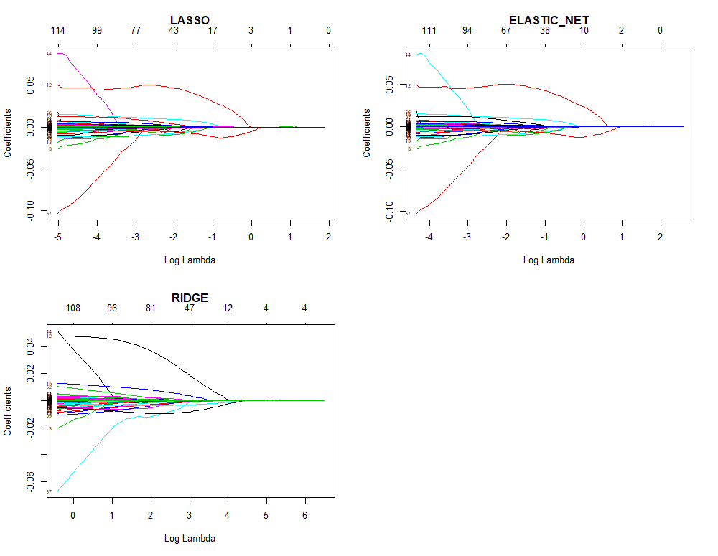
Negative Binomial Regression Regularizations

Slide 7
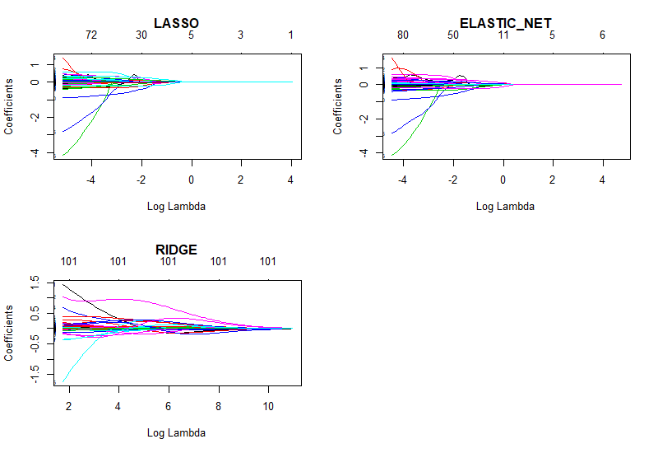
Gaussian Regression(standard LM) Regularization

Slide 8
BUILD THE FINAL MODELS
Despite the fact that, it is really impressive to look the shrinkage of the coefficients through different regularization techniques through the values of λ; these plots do not give us any useful information for our models. We want to find the best lambda that will give us the best features. In order to achieve that we do cross-validation and we try to find the parameters that gives us the smaller mean squared errors. When we find the optimal lambdas, we will build Generalized Linear Models with the predictors that LASSO gives us for the optimal lambda.
In general, the values of the coefficient that regularization techniques gives us are not optimal. We just use the results of the coefficients to see which of them did not converge to zero.
We extract the effective features(non-zero coefficients) that LASSO and ELASTINET give us for the optimal lambdas.
Then we fit Generalized Regression Models(Poisson, Negative Binomial and the updated classic Gaussian) according to the effective parameters we took from the regularization process.

Slide 9
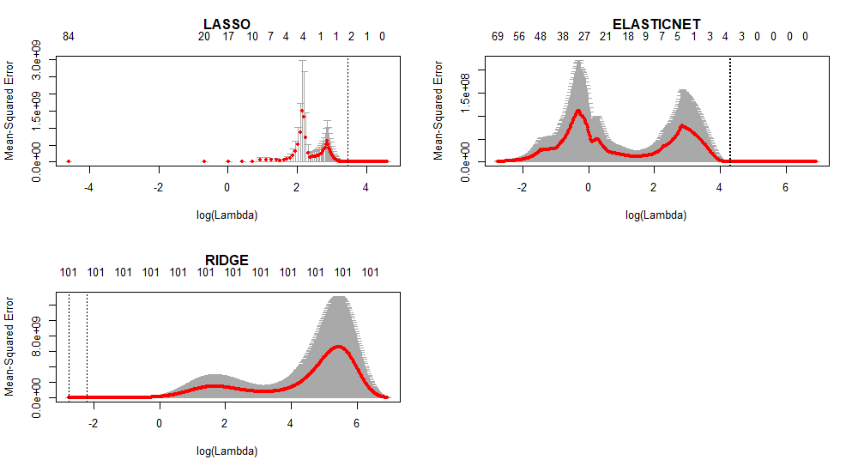
CV for Poisson Regression
Lambdas
Min 1se
LASSO 32.16 32.14
Elas.Net 72.72 74.15
Ridge 0.0625 0.10
We observe huge lambdas. This probably implies that we have too many colinear features!
However, it is very interesting that different type of measures give very different lambdas. For example type.measure = ‘dev’ gives lambda = 0.1 and ‘mae’ ~1.5.

Slide 10
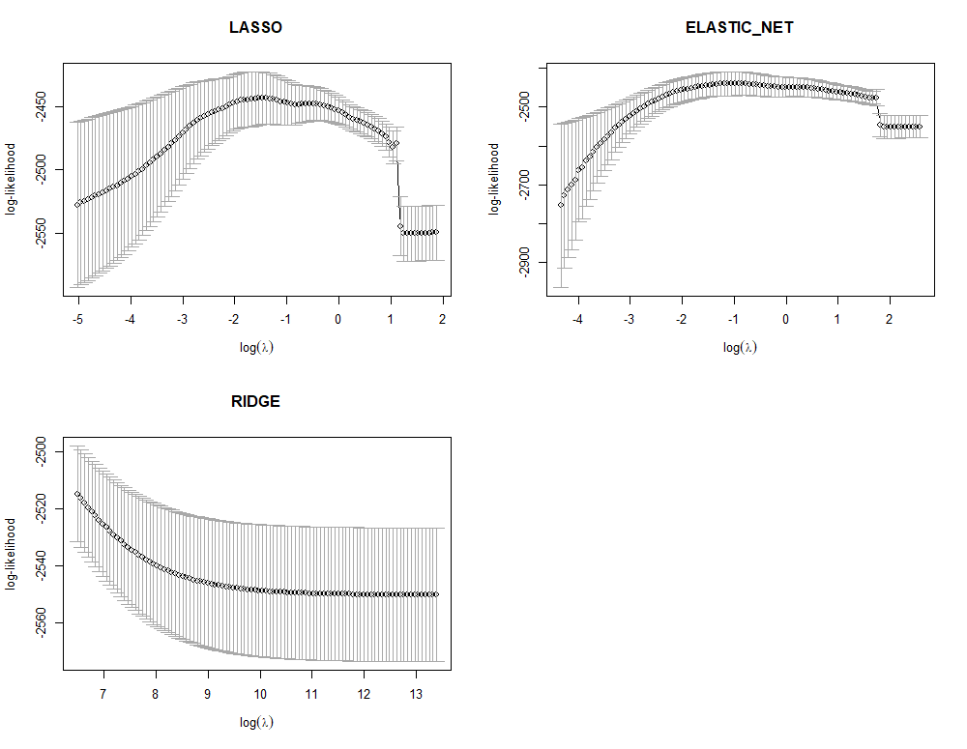
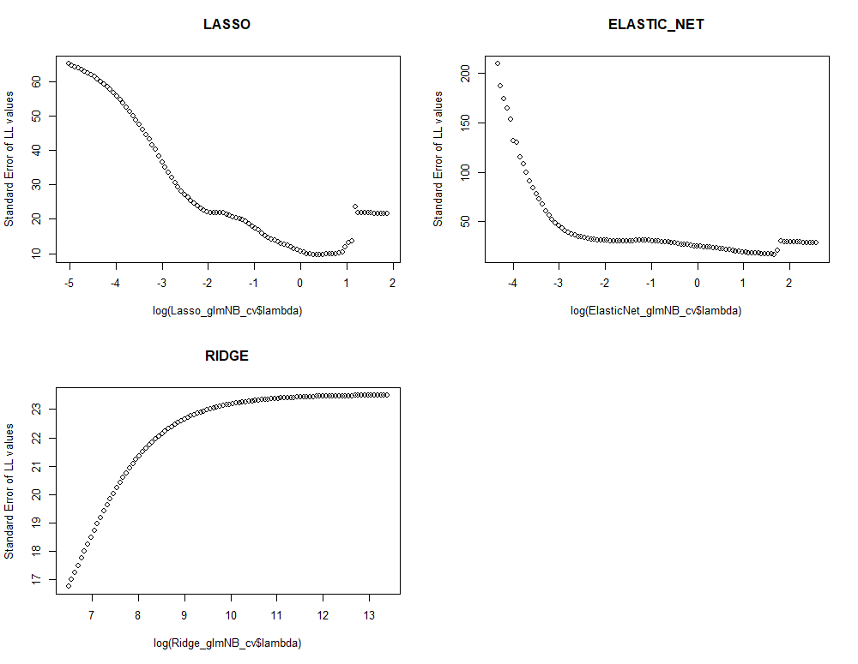
CV for Negative Binomial
cv.glmregNB() build-in plot
Custom plot
Optimal lamdas:
Lasso: 0.23057
ElasticNet: 0.401084
Ridge: ~600 !

Slide 11
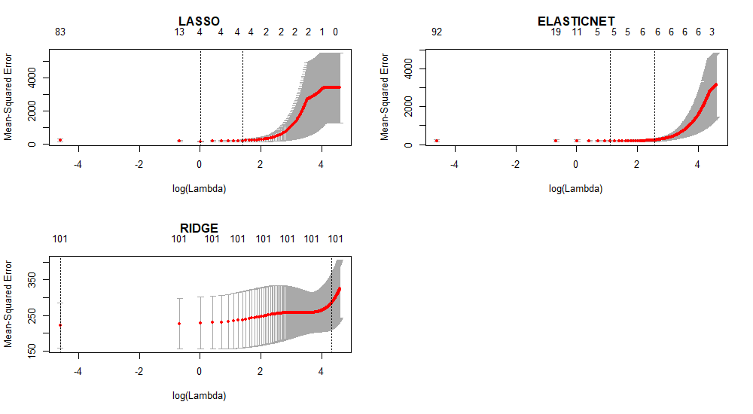
CV for Gaussian Regression
MIN 1SE
LASSO: 4.5321 8.5518
Elastnet:5.5370 14.0789
RIDGE: 2.5223 64.827

Slide 12
Final Models
Poisson Regression
After some exploration of the coefficients that each different type measure(mae, mse, dev ,etc) give us we ended up on the following predictors for our Poisson Regression.
Features: houseVacant, persPoverty, pctKids2Par, perHoush, medNumBedrm
Summary:
Gaussian Regression
Features: persPoverty, kidsBornNevrMarr, numForeignBorn, houseVacant
Summary:
 | Estimate | Std.Error | z.value | Pr(>z)
(Intercept) | 6.027029 | 0.079382 | 75.9241 | 0
houseVacant | 5.36E-05 | 4.28E-07 | 125.3106 | 0
persPoverty | -2.85E-06 | 5.58E-08 | -50.9906 | 0
pctKids2Par | -0.0762 | 0.000587 | -129.84 | 0
perHoush | 0.425866 | 0.024937 | 17.07762 | 2.18E-65
medNumBedrm | -0.30544 | 0.018005 | -16.9648 | 1.50E-64
 | Estimate | Std.Error | z.value | Pr(>z)
(Intercept) | 6.027029 | 0.079382 | 75.9241 | 0
houseVacant | 5.36E-05 | 4.28E-07 | 125.3106 | 0
persPoverty | -2.85E-06 | 5.58E-08 | -50.9906 | 0
pctKids2Par | -0.0762 | 0.000587 | -129.84 | 0
perHoush | 0.425866 | 0.024937 | 17.07762 | 2.18E-65
medNumBedrm | -0.30544 | 0.018005 | -16.9648 | 1.50E-64

Slide 13
Negative Binomial Regression
Feutures: persHomeless, houseVacant, pctNotSpeakEng, persPoverty
 | Estimate | Std.Error | z.value | Pr(>z)
(Intercept) | -0.05573 | 0.041371 | -1.34698 | 0.177986
persHomeless | -0.00143 | 0.000291 | -4.91261 | 8.99E-07
houseVacant | 0.000109 | 1.31E-05 | 8.332109 | 7.94E-17
pctNotSpeakEng | 0.069103 | 0.007583 | 9.112959 | 8.02E-20
persPoverty | 5.77E-05 | 3.16E-06 | 18.25613 | 1.85E-74
Conclusion
We built one model for each regression.
We could compare them and finally pick the best of the three models but we avoid to measure the performance of each model, on the data that we have already train them, because this would be overfitting. In order to do that we should have splitted the data to train and test set from the beginning.
We observe that the percentage of people under poverty level the and the number of vacant houses are two variables that are included in all the three regressions
In the R code there are much more details about the process. There are more plots, measurements, comments the ETL process.

